Slide 1

UNIT-3

Slide 2
  Trees
  Binary Trees
  Terminology
  Representation
  Tree Traversals
  Graphs
  Terminology
  Representation
  Graph Traversals
    DFS and BFS

Slide 3
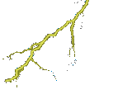















Trees

Slide 4
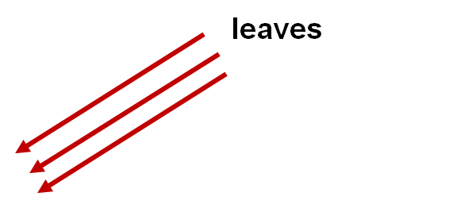

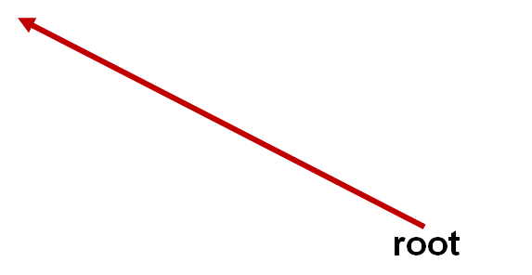
General View of a Tree

Slide 5

Computer Scientist’s View
root
leaves
branches
nodes
Notes:
Branches meet at nodes.

Slide 6
Tree
A tree, is a finite set of nodes together with a finite set of directed edges(links/branches) that define parent-child (Hierarchical )relationships.
Example:
Nodes = {A,B,C,D,E,F,G,H}
Edges = {(A,B),(A,E),(B,F),(B,G),(B,H),(E,C),(E,D)}
A tree is a finite set of one or more nodes such that:
  There is a specially designated node called the root.
  Remaining nodes are partitioned into ‘n’ (n>0) disjoint sets
  T1,T2,..Tn, where each Ti (i=1,2,….n) is a Tree, T1,T2,..Tn are called sub tree of the root.
Tree is a non-linear data structure.
A
E
B
D
C
F
H
G

Slide 7
A tree satisfies the following properties:
  It has one designated node, called the root, that has no parent.
  Every node, except the root, has exactly one parent.
  A node may have zero or more children.
  There is a unique directed path from the root to each node.
5
5
5
1
3
2
3
2
3
2
4
1
6
4
6
4
1
6
tree
Not a tree
Not a tree

Slide 8
Tree Terminology
Example: A
Root: Only node with no parent
Parent of x: The node directly above node x in the tree
Child of x: A node directly below node x in the tree
Siblings: Nodes with common parent.
Non-leaf or Internal Node: Nonleaf node.
Path: A sequence of connected nodes.
Ancestor of x: A node on the path from the root to x.
Descendent of x: A node on a path from x to a leaf.
Empty Tree: A tree with no nodes.
Leaf or External Node: A node with no children.
(A, B, C, H)
(B,C,D,E,F,G,H,I)
(B,C),(D,E),(F,G,H)
(B,C,H)
(A,B,D), (A,C,H,I), ...
For D (A,B)
For C (H,I)
(D,E,F,G,I)
A
B
C
D
E
F
G
H
I

Slide 9
The level of a node x: It is the distance from the root to node x.
Generally, the root has a zero distance from itself, the root is at level 0.
The, children of the root are at level 1, their children are at level at 2, and so on.
Height of Tree: The maximum no of nodes covered in a path
starting from root node to a leaf node is called height of a tree.
Depth: Length of the path to that node from the root.
Degree/arity of node x: Number of children's of a node x.
Level of j: 3
Height of a following tree: 5
3 for G
Degree of c: 3
Level 0
Level 1
Level 2
Level 3
Level 4
A
A
B
C
D
E
F
G
H
I
J
k

Slide 10
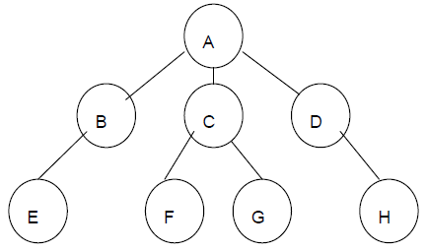
Example 2:

Slide 11
TERM | DESCRIPTION | EXAMPLE
Node | An item or single element represented in a tree | A,B,C…….,H
Root | Node that does not have any ancestors (parent or Grandparent) | A
Sub tree | Internal nodes in a tree which has both ancestor(parent) and descendant(child) | B,C,D
Leaf | External nodes that does not have any descendant(child) | E,F,G,H
Edge | The line depicts the connectivity between two nodes | (A-B),(A-C)…
Path | Sequence of nodes connected | A-B-E for E from root
Height | Length of the longest path from the root | 3
Depth | Length of the path to that node from the root | 2 for D
Degree of a node | Number of children connected from that node | 3 for A, 1 for B,D, 2 for C and 0 for leaves
Degree of a tree | Degree of a node which has maximum degree | 3 (since A has Max. degree)

Slide 12
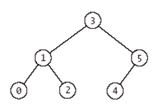
Binary Tree
In a binary tree, each node has at most two sub trees.
A binary tree(T) is a finite set of nodes such that:
→ T is empty tree (called empty binary tree)
→ T contains a specially designed node called the root of T, and remaining nodes of T form two disjoint binary trees T₁ and T₂ which are called left sub tree and right sub tree respectively.
Note: A binary tree is a tree in which no nodes can have more than two children.

Slide 13
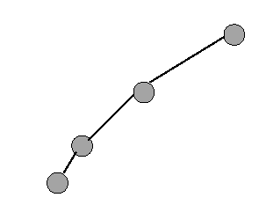
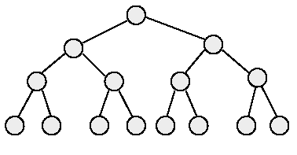
Binary Tree Properties
A binary tree with n elements, n > 0, has exactly n-1 edges.
A binary tree of height h, h >= 0, has at least h and at most 2^{h}-1 elements or nodes in it.
The height of a binary tree that contains n elements, n >= 0, is at least ⎡(log₂(n+1))⎤ and at most n.
Minimum and Maximum number of elements for height 4
minimum number of elements
maximum number of elements

Slide 14
Difference between tree and binary tree
Trees
1) Tree never be empty.
2) A node may have any no of nodes/children’s.
Binary tree
1) Binary tree may be empty.
2) A node may have at most 2 children's or 0 or1 children.

Slide 15
Full binary tree
A full binary tree is a tree in which every node other than the leaves has two children.
    Note: All leaves are at same level and all other nodes each have two children.
A full binary tree of height h has exactly 2^{h}-1 nodes.
1
Level 0- 1node
2
3
Level 1- 2nodes
4
5
6
7
Level 2- 4nodes
10
12
13
14
15
Level 3-8nodes
8
9
11

Slide 16
Complete binary tree
A complete binary tree is a binary tree in which every level is completely
filled except possibly the last level.
In the unfilled level, the nodes are attached starting from the left-most position.
1
Level 0- 1node
2
3
Level 1- 2 nodes
4
5
6
7
Level 2- 4 nodes
8
9
Level 3- 2 nodes

Slide 17
Balanced Binary Tree
Balanced binary tree is a binary tree in which the left and right sub trees
height must be differed by at most 1.
1
2
3
Left sub tree height = 3
Right sub tree height = 2
4
5
6
7
Difference = 1
8
9

Slide 18
Left skewed binary tree
If the right subtree is missing in every node of tree then we call it as left skewed tree.
Right skewed binary tree
If the left subtree is missing in every node of a tree then we call it is right subtree.
A
B
C
A
B
C

Slide 19
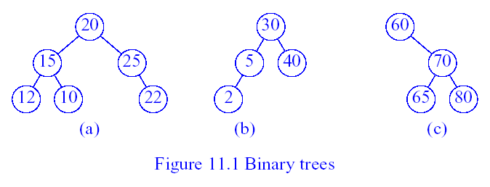
Binary Search Tree
A binary search tree is a nonempty binary tree that satisfies the following
properties:
  Each node has a key/element (or value), and no two nodes have the same key (i.e., all keys are distinct).
  For every node x, all keys/elements in the left sub tree of x are smaller than x.
  For every node x, all keys in the right sub tree of x are larger than or equal to x.
  The left and right sub trees of the root are also binary search trees.
Fig (a) is not a BST where as Fig (b) and (c) are BST’s

Slide 20
Binary Search Tree Operations
1. Searching:
Search begins at the root.
If the root is NULL, the search tree is empty and the search fails.
If key is less than the root, then left subtree is searched.
If key is greater than the root, then right subtree is searched.
If key equals the root, then the search terminates successfully.
20
Search for 8
10
40
6
15
30
2
8
25

Slide 21
2.Insertion:
Binary Search Tree Operations
To insert a new element into a binary search tree, we must first verify that its key does not already exist by performing a search in the tree.
If the search is successful, we do not insert.
If the search is unsuccessful, then the element is inserted at the point the search terminated.
Insert 35
20
10
40
6
15
30
2
8
25
35

Slide 22
3.Deletion:
Binary Search Tree Operations
There are three cases for the element to be deleted:
  Element is in a leaf.
  Element is in a degree 1 node (i.e., has exactly one nonempty subtree).
  Element is in a degree 2 node (i.e., has exactly two nonempty subtrees).
Case 1: Delete from a Leaf.
For case 1, we can simply discard the leaf node.
Example, delete a leaf element. Key = 7.
20
10
40
6
15
30
2
8
18
25
35
7

Slide 23
Case 2: Delete from a Degree 1 Node
20
Delete 40
10
40
6
15
30
2
8
18
25
20
Delete 15
10
6
15
30
2
8
18
25

Slide 24
Case 3: Delete from a Degree 2 Node
20
10
40
6
15
30
2
8
18
25
35
7
Replace with the largest key in the left subtree (or the smallest in the right subtree)
20
8
40
6
15
30
2
8
18
25
35
7

Slide 25
Representation of a Binary Tree using Array
Sequential Representation :
→ Tree nodes are stored in a linear data structure like array.
→ Root node is stored at index ‘0’
→ If a node is at a location ‘i’, then its left child is located at 2 * i + 1 and right child is located at 2 * i + 2
The space required by a binary tree of height h is 2^{h}-1.

Slide 26
Example: Sequential representation
0
A
1
2
B
D
3
5
G
6
C
E
F
12
A B D C . E G . . . . . F
0 1 2 3 4 5 6 7 8 9 10 11 12 13 14

Slide 27
Disadvantages of Static Representation
Advantages of array/sequential/static representation
Any node can be accessed from any other node by calculating the index and this is efficient from execution point of view.
There is no overhead of maintaining the pointers.
The major disadvantage with this type of representation is wastage of memory. Example: In the skewed tree, half of the array is unutilized.
Allows only static representation. There is no possible way to enhance the size of the tree.
Inserting a new node and deleting a node from it are inefficient with this representation because these require considerable data movement up and down the array which demand excessive processing time.

Slide 28
Representation of Binary Tree using Linked List
The most popular way to present a binary tree.
Each element is represented by a node that has two link fields (leftChild and rightChild) plus an element field .
The space required by an n node binary tree is n * sizeof a node.
struct node { /* a node in the tree structure */
struct node *lchild;
int data ;
struct node *rchild;
};
→The pointer lchild stores the address of left child node.
→The pointer rchild stores the address of right child node.
→If child is not available NULL is stored.
→A pointer variable root represents the root of the tree.

Slide 29
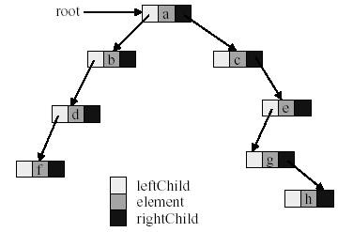
Linked Representation of Binary Tree

Slide 30
Advantages of linked representation
This representation is superior to the array representation as there is no wastage of memory.
There is no need to have prior knowledge of depth of the tree. Using dynamic memory allocation concept one can create as much memory (node) as required.
Insertion and deletion which are the most common operations can be done without moving the other nodes.
Disadvantages of linked representation
This representation does not provide direct access to a node.
It needs additional space in each node for storing the left and right subtrees.

Slide 31
Binary Tree Traversal Techniques
There are three recursive techniques for binary tree traversal.
1. Preorder Traversal
2. Inorder Traversal
3. Postorder Traversal

Slide 32
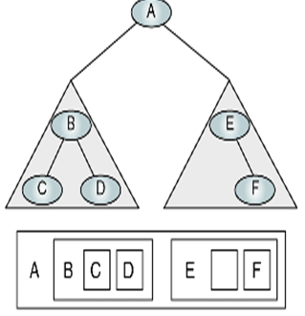
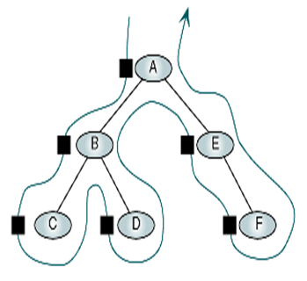
Algorithm preOrder (root)
Traverse a binary tree in root-left-right
Pre Condition: root is the entry node of a tree or subtree
Post Condition: each node has been processed in order
1. if(root is not null)
1. process(root)
2. preOrder(leftsubtree)
3. preOrder(rightsubtree)
2. end if
end preOrder

Slide 33
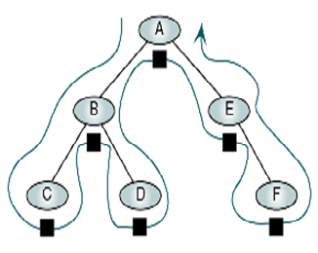
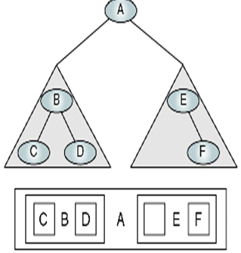
Algorithm inOrder (root)
Traverse a binary tree in left-root-right
Pre Condition: root is the entry node of a tree or subtree
Post Condition: each node has been processed in order
1. if(root is not null)
1. inOrder(leftsubtree)
2. process(root)
3. inOrder(rightsubtree)
2. end if
end inOrder

Slide 34
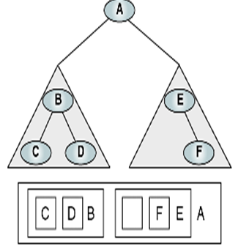
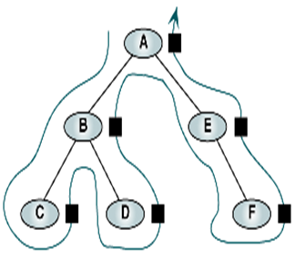
Algorithm postOrder (root)
Traverse a binary tree in left-right-root
Pre Condition: root is the entry node of a tree or subtree
Post Condition: each node has been processed in order
1. if(root is not null)
1. postOrder(leftsubtree)
2. postOrder(rightsubtree)
3. process(root)
2. end if
end postOrder

Slide 35
Preorder of binary tree
A
B
C
D
E
F
G
H
J
I
K
Preorder: A B D E H I C F J K G

Slide 36
Inorder of binary tree
A
B
C
D
E
F
G
H
J
I
K
Inorder: D B H E I A F K J C G

Slide 37
Postorder of binary tree
A
B
C
D
E
F
G
H
J
I
K
Postorder: D H I E B K J F G C A

Slide 38
Write pre,in and post order of the following tree:
(A-B) + C* (D/E)
+
-
*
A
B
C
/
D
E

Slide 39
Preorder for the following tree
+
-
*
A
B
C
/
D
E
Preorder: + - A B * C / D E

Slide 40
Inorder of the following tree
+
-
*
A
B
C
/
D
E
Inorder: A - B + C * D / E

Slide 41
Postorder of the following tree
+
-
*
A
B
C
/
D
E
Postorder: A B - C D E / * +

Slide 42
/* Write a C program that uses functions to perform the following:
i) Creating a Binary Tree of integers.
ii) Traversing the above binary tree in preorder, inorder and postorder.*/
bnode* getnode(int ele)
{
bnode *q = (bnode*)malloc(sizeof(bnode));
if(q)
{
q -> data = ele;
q -> lchild = NULL;
q -> rchild = NULL;
return q;
}
else
{
printf("\n Unable to create the node");
exit(0);
}
return 0;
}
#include <stdio.h>
#include <conio.h>
struct node
{
int data;
struct node *lchild,*rchild;
};
typedef struct node bnode;

Slide 43
void preorder(bnode *root)
{
if(root)
{
printf("%5d",root->data);
preorder(root->lchild);
preorder(root->rchild);
}
}
void inorder(bnode *root)
{
if (root)
{
inorder(root->lchild);
printf("%5d",root->data);
inorder(root->rchild);
}
}
void postorder(bnode *root)
{
if(root)
{
postorder(root->lchild);
postorder(root->rchild);
printf("%5d",root->data);
}
}

Slide 44
bnode* insert(bnode *root, int ele)
{
if(!root)
{
bnode *q = getnode(ele);
root = q;
}
else
if(root->data < ele)
root->rchild = insert(root->rchild, ele);
else
if(root -> data > ele)
root -> lchild = insert(root -> lchild, ele);
else
{
printf("\n Duplicate data ");
}
return root;
}

Slide 45
void main() {
int ch, ele;
bnode *root = NULL;
printf("\n Binary Search Tree Operations :");
printf("\n\t 1) Insert \n\t 2) Preorder \n\t 3) Inorder\n\t4 ) Postorder \n\t 5) Exit"); while(1) {
printf("\n Enter your choice :");
scanf("%d", &ch);
switch(ch) {
case 1: printf("\n Enter an element :");
scanf("%d", &ele);
root = insert(root, ele); break;
case 2: preorder(root); break;
case 3: inorder(root); break;
case 4: postorder(root); break;
case 5: exit(0);
default : printf("\n Invalid choice.");
}//switch
}
}//main

Slide 46
Applications of Trees
Trees are very important data structures in computing.
They are suitable for:
  Hierarchical structure representation, e.g.,
    File directory.
    Organizational structure of an institution.
    Class inheritance tree.
  Problem representation, e.g.,
    Expression tree.
    Decision tree.
  Efficient algorithmic solutions, e.g.,
    Search trees.
    Efficient priority queues via heaps.

Slide 47
Introduction to Graphs
Definition: A graph G is a pair, G = (V, E), where V is a finite nonempty
set of vertices and E is called the set of edges.
Example:
a
b
c
d
e
V= {a,b,c,d,e}
E=(a,b), (a,c), (a,d), (b,e), (c,d), (c,e), (d,e)}

Slide 48
Graph Terminology
A directed graph or digraph is one in which the edges have a direction.
An undirected graph is one in which the edges do not have a direction.
The size of a graph is the number of nodes in it
The empty graph has size zero (no nodes).
If two nodes are connected by an edge, they are neighbors (and the nodes are adjacent to each other).
A path is a sequence of nodes such that each node (but the last) is the predecessor of the next node in the list.
Example: If v₁,v₂,. . .,v_{k} are vertices then v_{i} and v_{i}+1 should be consecutive.

Slide 49
The degree of a node is the number of edges it has.
For directed graphs:
  The in-degree of a node is the number of in-edges it has.
  The out-degree of a node is the number of out-edges it has.
An undirected graph is connected if there is a path from every node to every other node.
A directed graph is strongly connected if there is a path from every node to every other node.

Slide 50
A simple path is a path in which all the vertices, except possibly the first and last vertices, are distinct.
A cycle in G is a simple path in which the first and last vertices are the same.
A graph without cycles is called acyclic graph.
Sub graph is a graph with subset of vertices and edges of a graph.
A graph is called a simple graph if it has no loops and no parallel edges.
A graph is termed as weighted graph if all the edges in it are labeled with some weights.
A complete graph is a graph if there is a path from every node to every other node.

Slide 51
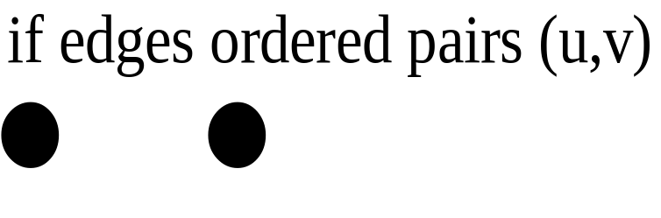
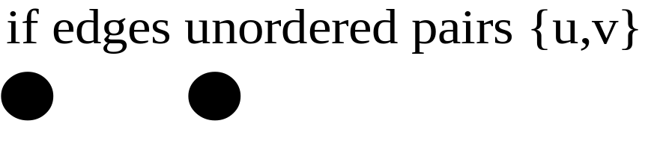
Directed
Un Directed
u
v
u
v
G₂
0
G1
3
in:1, out: 1
0
1
in: 1, out: 2
3
1
2
3
3
3
2
in: 1, out: 0

Slide 52
Cyclic graph
Acyclic graph
Weighted Graph
A
A
A
10
9
B
C
B
C
B
C
6
D
D
Complete Graph
Strongly Connected
A
B
A
D
B
C
D
E
C

Slide 53
0
0
0
1
2
0
1
2
1
2
3
1
2
3
G1
3
(i) ii) (iii) (iv)
(a) Some of the sub graph of G₁
0
0
0
0
1
1
1
2
2
G₂
(i) (ii) (iii)
(b) Some of the sub graph of G₂

Slide 54
Representation of a Graph
There are two ways of representing a graph in memory:
  Sequential Representation by means of Adjacency Matrix.
  Linked Representation by means of Linked List.

Slide 55
Adjacency Matrix is a bit matrix which contains entries of only 0 and 1
The connected edge between two vertices is represented by 1 and absence of edge is represented by 0.
This representation uses a square matrix of order n x n, where n is the number of vertices in the graph.
Adjacency matrix of an undirected graph is symmetric.
Adjacency Matrix
A
A B C D E
A 0 1 1 1 0
B 1 0 1 1 0
C 1 1 0 1 1
D 1 1 1 0 1
E 0 0 1 1 0
B
C
D
E

Slide 56
Linked List Representation
It saves the memory.
The number of lists depends on the number of vertices in the graph.
The header node in each list maintains a list of all adjacent vertices of a
node .
A
B
C
D | NULL
A
B
A
C
D | NULL
A
B
D
E | NULL
B
C
C
D
A
B
C
E | NULL
D
E
N
E
C
D | NULL

Slide 57
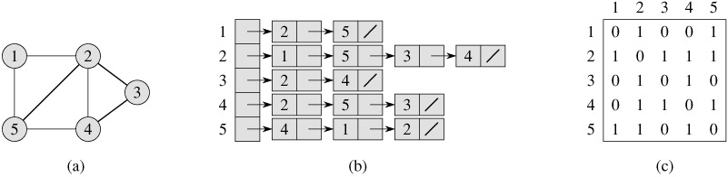
Undirected Graph
Adjacency List
Adjacency Matrix

Slide 58
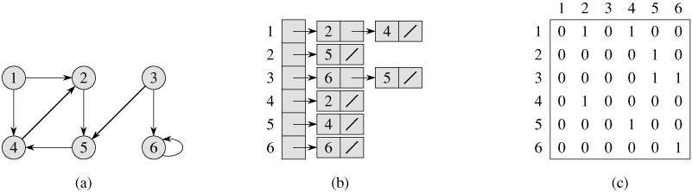
Directed Graph
Adjacency List
Adjacency Matrix

Slide 59
Graph Traversal Techniques
There are two standard graph traversal techniques:
  Depth-First Search (DFS)
  Breadth-First Search (BFS)
Traversing a graph means visiting all the vertices in the graph exactly once.
DFS and BFS traversals result an acyclic graph.
DFS and BFS traversal on the same graph do not give the same order of visit of vertices.

Slide 60
Depth First Traversal:
The depth first traversal is similar to the in-order traversal of a binary tree.
An initial or source vertex is identified to start traversing, then from that vertex
any one vertex which is adjacent to the current vertex is traversed.
To implement the depth first search algorithm, we use a stack.
DFS follows the following rules:
  Select an unvisited node x, visit it, and treat as the current node
  Find an unvisited neighbor of the current node, visit it, and make it the new current node;
  If the current node has no unvisited neighbors, backtrack to the its parent, and make that parent the new current node.
  Repeat steps 3 and 4 until no more nodes can be visited.
  If there are still unvisited nodes, repeat from step 1.

Slide 61
Breadth First Traversal:
The breadth first traversal is similar to the pre-order traversal of a binary tree.
The breadth first traversal of a graph is similar to traversing a binary tree
level by level (the nodes at each level are visited from left to right).
All the nodes at any level, i, are visited before visiting the nodes at level i + 1.
To implement the breadth first search algorithm, we use a queue.
BFS follows the following rules:
  Select an unvisited node x, visit it, have it be the root in a BFS tree being formed. Its level is called the current level.
  From each node x in the current level, visit all the unvisited neighbors of x. The newly visited nodes from this level form a new level that becomes the next current level.
  Repeat step 2 until no more nodes can be visited.
  If there are still unvisited nodes, repeat from Step 1.

Slide 62
Example1:
Graph
A
B
C
D
E
A
B
C
D
A
E
B
C
D
The Depth First Search Tree Order : A, B, E, D, C
E
The Breadth First Search Tree Order : A, B, C, D, E

Slide 63
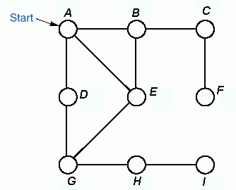

Example2:
A
B
C
A
B
C
D
E
F
D
E
F
G
H
I
G
H
I
DFS Traversal Order
BFS Traversal Order
A B C F E G D H I
A B D E C G F H I

Slide 64
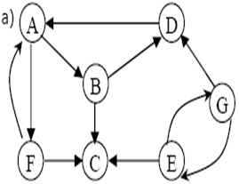
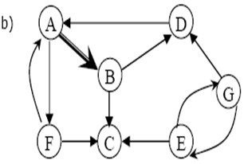
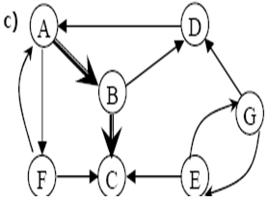
Example3: Construct the DFS and BFS for the following graph.
Depth First Search:
Given Graph
From start vertex A explore edges.
From vertex B either C or D to be explored.

Slide 65
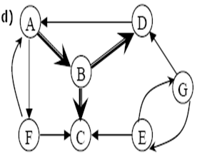
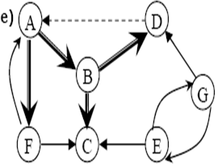
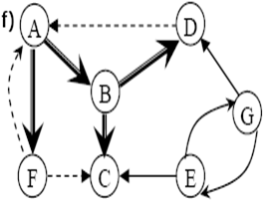
Since C is dead end, backtrack to B, from there explore D.
From D it is possible to explore A, but this would form a cycle, so again backtrack to B, from there backtrack to A, explore the path to F.
The DFS Tree Order : A, B, C, D, F
From F it is possible to traverse either A or c, but both are discovered already. So F is also a dead end.
Note: From the above diagram it is possible to say that G and E are never traversed.

Slide 66
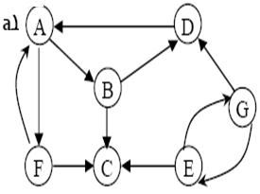
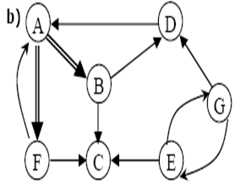
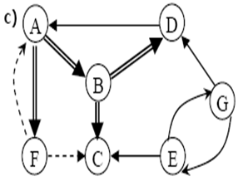
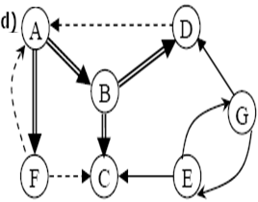
Breadth First Search:
The BFS Tree Order : A,B,F,C,D
Given Graph.
From the start vertex A, the explored
vertices are B and F.
Explore all paths from vertex B and F.
The dashed lines indicate, nodes are
previously discovered.
From D the explored vertex is A.
But A is already visited.
Note: From the above diagram it is possible to say that G and E are never traversed.

Slide 67
Applications of Graphs
Electronic circuits
  Printed circuit board
  Integrated circuit
Transportation networks
  Highway network
  Flight network
Computer networks
  Local area network
  Internet
  Web
Databases
  Entity-relationship diagram

Slide 68
Spanning Trees
A spanning tree of a graph is just a sub graph that contains all the vertices and
is a tree.
A graph may have many spanning trees.
Graph A
Some Spanning Trees from Graph A
or
or
or

Slide 69
Minimum Spanning Trees
The minimum spanning tree for a given graph is the spanning tree of
minimum cost for that graph.
Weighted Graph
Minimum Spanning Tree
7
2
2
5
3
3
4
1
1
Algorithms to find Minimum Spanning Trees are:
  Kruskal‘s Algorithm
  Prim‘s Algorithm

Slide 70
Kruskal’s algorithm
Kruskal’s algorithm finds the minimum cost spanning tree by selecting the
edges one by one as follows.
1. Draw all the vertices of the graph.
2. Select the smallest edge from the graph and add it into the spanning tree
(initially it is empty).
3. Select the next smallest edge and add it into the spanning tree.
4. Repeat the 2 and 3 steps until that does not form any cycles.

Slide 71
5
A
B
4
6
2
C
2
D
3
3
1
2
E
F
4
Minimum Spanning Tree for the above graph is:
A
B
2
C
2
D
2
3
1
E
F

Slide 72
Prim’s algorithm
Prim’s algorithm finds the minimum cost spanning tree by selecting the
edges one by one as follows.
All vertices are marked as not visited
Any vertex v you like is chosen as starting vertex and is marked as visited (define a cluster C).
The smallest- weighted edge e = (v,u), which connects one vertex v inside the cluster C with another vertex u outside of C, is chosen and is added to the MST.
4. The process is repeated until a spanning tree is formed.

Slide 73
5
A
B
4
6
2
C
2
D
3
3
1
2
E
F
4
Adjacency matrix
Minimum Spanning Tree for the above graph is:
 | A | B | C | D | E | F
A | - | 5 | 4 | 6 | 2 | -
B | 5 | - | - | 2 | - | 3
C | 4 | - | - | - | 3 | -
D | 6 | 2 | - | - | 1 | 2
E | 2 | - | 3 | 1 | - | 4
F | - | 3 | - | 2 | 4 | -
A
B
2
C
2
D
3
1
2
E
F

Slide 74
Exercise:
1
5
6
1
4
2
5
5
3
3
4
2
6
5
6
6

